Slide 1
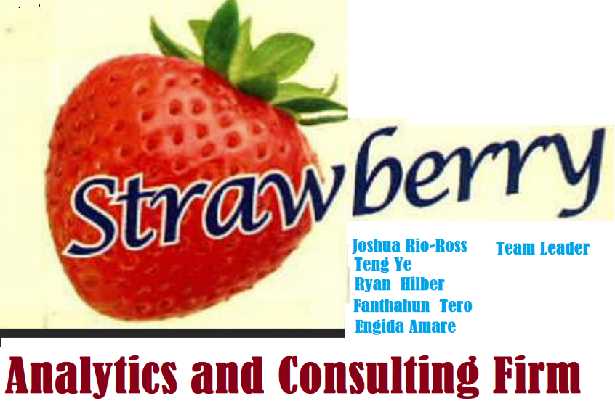
Analysis results and Recommendation made to App trader company
Introduction
Strawberry Analysis and Consulting Firm would like to thank App
trader company for the trust they put on us in order to accomplishment their
requirement .

Slide 2
Top ten Applications that are found on both App and Google stores based on their Expected Profit
As Seen in the left chart An App by the name ‘PewDiePie's Tuber Simulator ‘ Is the top priority in our recommendation list for the App_trader company .
Those application with a variety of Angry Bird (Angry Bird ..Blast, Epic RPG, Rio, Star Wars) each is in the highest profit margin and any application that is with in the Angry Bird variety may be good to be targeted .

Slide 3
Profitability of applications in terms of genre category
This summarized Chart shows the category to which the maximum
Applications that have A game nature are more profitable compared to the other types of category
Further drill down into the types of applications that makes the games applications are more profitable in terms of
Entertainment and Productivity hold the second and the third Ranks within this analysis .

Slide 4
Bests of the Bests
Our team come up with the Plan-B recommendation in case app trader wants to narrow their selection due to some unforeseen circumstances . In case best top 3 or best top 5
In this Bottom-line recommendation we tried to emphasize on Apps that fulfills all or many of the selection criteria aforementioned .
Apps found in both Apple Store and Play store .
Apps that generate Maximum expected Profit.
Apps that demanded Minimum possible cost
Apps that having a genre of maximum choice.
Apps that are a chosen across the different Text content.
Apps having a maximum possible review count or maximum installation count
On the left best recommended top 3 Apps .
Rank | Application Name
1 | PewDiePie's Tuber Simulator
2
3

